Slide 1

SIH-2023 (SMART AUTOMATION)
Introducing the Student Scholarship and Scheme App IDEAS 📱
Our cutting-edge AI technology ideas helps students easily find and apply for scholarships and government schemes, recommending suitable opportunities based on their academic performance, interests, financial status, and more with the help of AI.
By- Tech-Army

Slide 2

The Benefits of the App for Students 👩‍🎓
Save time ⏰
Improve chances of success 🎉
Reduce stress 😌
Quick access to all necessary information and applications in a centralized location saves students valuable time.
With our app, students can eliminate the anxiety of searching for scholarships and schemes on their own.
Our advanced AI matching technology suggests opportunities suited to the student's eligibility for specific scholarships or schemes based on input criteria (e.g., academic performance, field of study, income status).
Personalized AI suggestions
Our app's AI algorithm takes into account various factors such as academic performance, interests, financial status, and more to provide students with personalized recommendations for scholarships, schemes, and other opportunities.

Slide 3

An Overview of Scholarships and Government Schemes 💰
1
Scholarships
Learn about the different types of scholarships available, including merit-based, need-based, athletic, and creative scholarships, and how each one can help you achieve your academic goals.
Government schemes
2
Discover the various government schemes provided to students in different areas such as education, agriculture, social welfare, and minority development, among others.
3
How to apply
Find out what you need to do to apply for the scholarships and government schemes you're interested in, including eligibility criteria, key dates, and application processes.
Private scholarships
4
Explore opportunities for private scholarships that are offered by organizations, corporations, foundations, and individuals. These scholarships can provide financial assistance for your education.

Slide 4

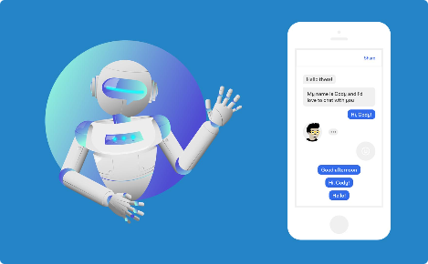


How Our AI Technology Works 🤖
Profile Matching
Real-time assistance
Our AI technology uses a student's profile and academic achievements to suggest the best scholarships and government schemes they may be eligible for.
A built-in chatbot feature provides students with real-time assistance, answering any questions they may have about the app, scholarships, or government schemes.
Income and eligibility check
Financial Calculator
Our app also checks a student's income status and eligibility criteria for the scholarships and government schemes they're interested in, providing recommendations accordingly.
Integrating a financial calculator, our app helps students estimate fees, tuition costs, and potential financial aid available, enabling them to plan their educational expenses effectively.

Slide 5
The Features of the App 🚀
1
Easy-to-use interface
2
Customization options
Our user-friendly interface makes it easy for students to navigate and find what they're looking for with just a click or swipe.
Students can customize their app experience by filtering scholarship and government scheme recommendations based on their preferences and interests.
3
Real-time notifications
4
Secure data management
Students receive instant notifications about new scholarships and government schemes added to the app that match their profile and interests.
Our app ensures the safe and secure management of student data and credentials through advanced encryption technology.

Slide 6
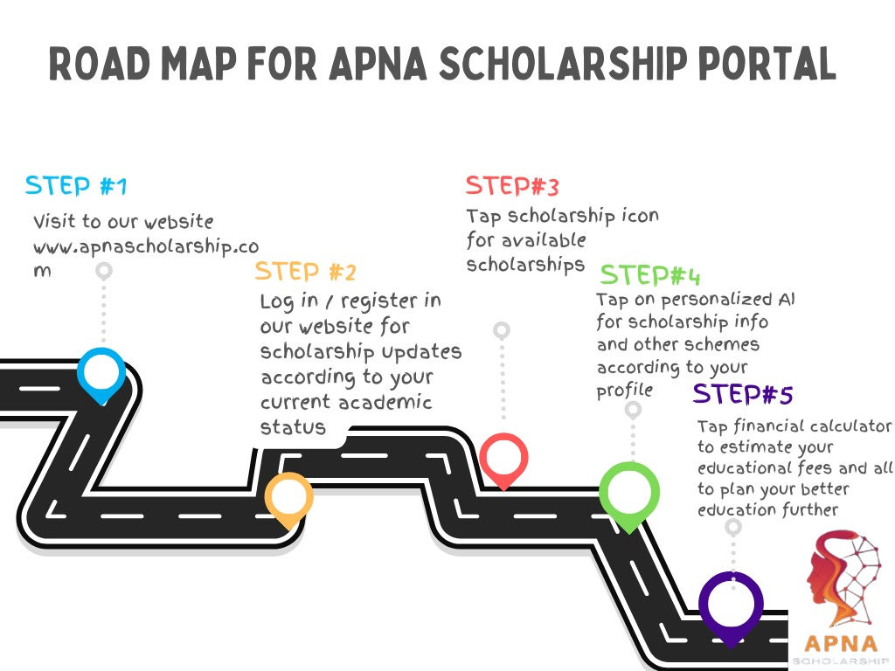

Slide 7

Conclusion 📣
Our app IDEAS provides unparalleled access to scholarships and government schemes for students from nursery to higher studies.

Slide 8

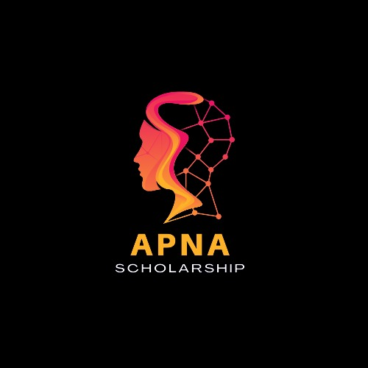





ABOUT OUR TEAM
TECHNICAL ADVISOR – Swapnanil Chowdhury
(AIML- 1st year)
WEB DEVELOPER- Subham Sharma (AIML- 1st year)
CONTAIN WRITER AND EXPLORER- Suranjana Paul (CSE – 1st year)
DESIGNER AND DEVELOPER- Diya Ghosh
(CSE- 1st year)
DATA RESEARCHER- Rajesh Yadav (AIML - 1st year)

